Slide 1


Working with Restricted Data at Cornell Flow

Slide 2
CCSS Research Support Code of Conduct
The Cornell Center for Social Sciences provides a welcoming environment for everyone embracing all backgrounds or identities. All instructors and attendees agree to abide by our community norms. We encourage the following behaviors in our workshops:
Respect differing viewpoints and ideas
Share your own perspectives and ask any questions
Accept constructive criticism
Use welcoming and inclusive language
Show courtesy and respect for all instructors and attendees
If you believe that an instructor or attendee has violated the code of conduct, please report the violation to CCSS-ResearchSupport@cornell.edu. We take all reported incidents seriously.

Slide 3
Land Acknowledgement
Cornell University is located on the traditional homelands of the Gayogo̱ hó꞉nǫ' (the Cayuga Nation). The Gayogo̱ hó꞉nǫ' are members of the Haudenosaunee Confederacy, an alliance of six sovereign Nations with a historic and contemporary presence on this land. The Confederacy precedes the establishment of Cornell University, New York state, and the United States of America. We acknowledge the painful history of Gayogo̱ hó꞉nǫ' dispossession, and honor the ongoing connection of Gayogo̱ hó꞉nǫ' people, past and present, to these lands and waters.
Here are additional links for more on the history of Cornell’s violent, colonial formation, the movement to return native lands, and about the AIISP program at Cornell.
Consider donating to the Gayogo̱ hó꞉nǫʼ sovereignty initiative here.

Slide 4
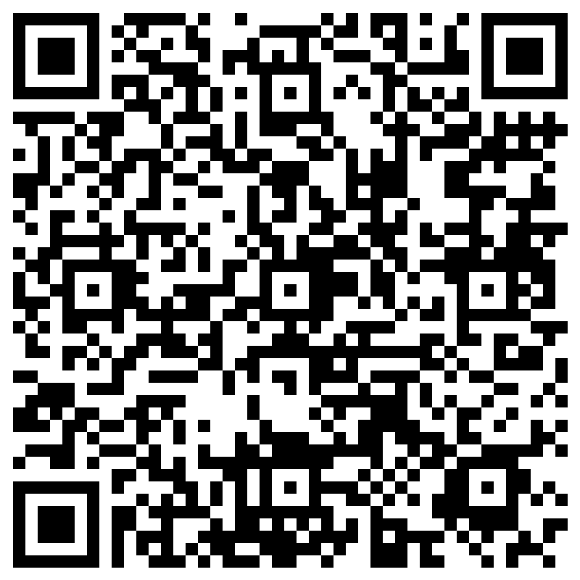
Attendance

Slide 5
Outline
Overview Approval Process
Demo Computing environments
Security
FAQs

Slide 6
Approval Process
Data that cannot be released directly to the public research community.
Identify faculty member who will oversee project.
Human subject research: Understand the data you are using. Consult CRADC or go through IRB website. CRADC assists with internal data use agreement.
https://researchservices.cornell.edu/sites/default/files/2019-05/IRB%20Decision%20Tree.pdf
Receiving from Data Provider: Research Services. Getting approval and acquiring data.
https://researchservices.cornell.edu/
Contact CRADC with security requirements to develop Data protection plan.

Slide 7
CCSS CRADC Computing Resources
CRADC Computing is end point. Data Uploaded directly to system.
Access to a wide variety of quantitative and qualitative CCSS software at no additional cost​. Software
Project based storage.
Standalone environments.

Slide 8
Security
Meet the individual requirements of each data provider
CRADC staff and Researchers abide to Data Use Agreements
Duo authentication, 14 character passwords, idle sessions of 15 minutes automatically disconnect(processes still run)
National Institute security and technology(NIST) 800-171 certified.
https://csrc.nist.gov/publications/detail/sp/800-171/rev-2/final
Requirements. Remote connection. VPN as additional layer. Bureau Labor Statistics(BLS) Add Health(AH).

Slide 9
FAQS
Project Expires. 2 months heads up. Act immediately to extend. Otherwise inactive. Create a new contract.
Transfer files(data, code, results, etc.).
No Internet Access, copy paste
Software additions(Python libraries, R packages, Stata packages)

Slide 10
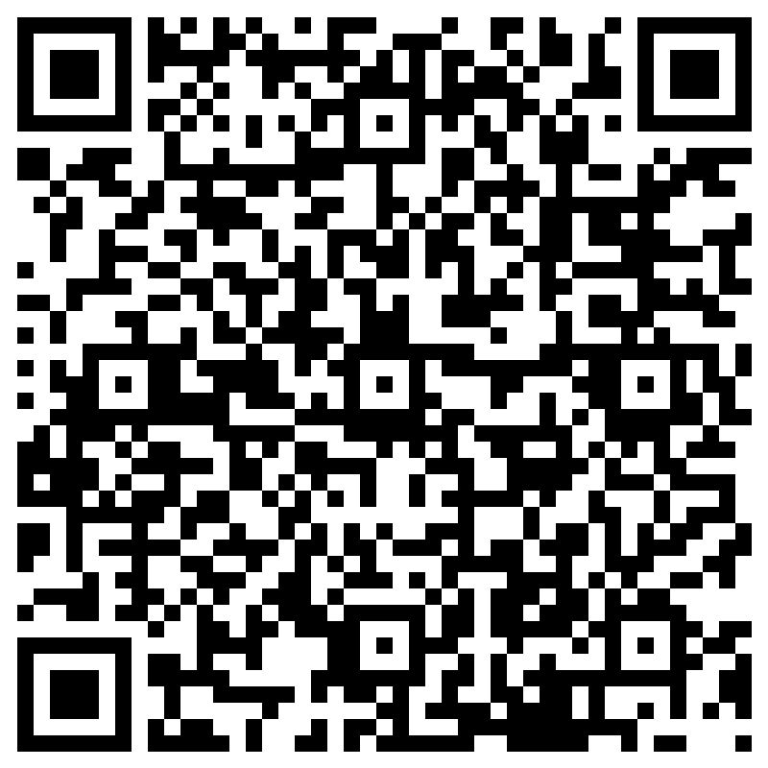
Evaluation

